Slide 1
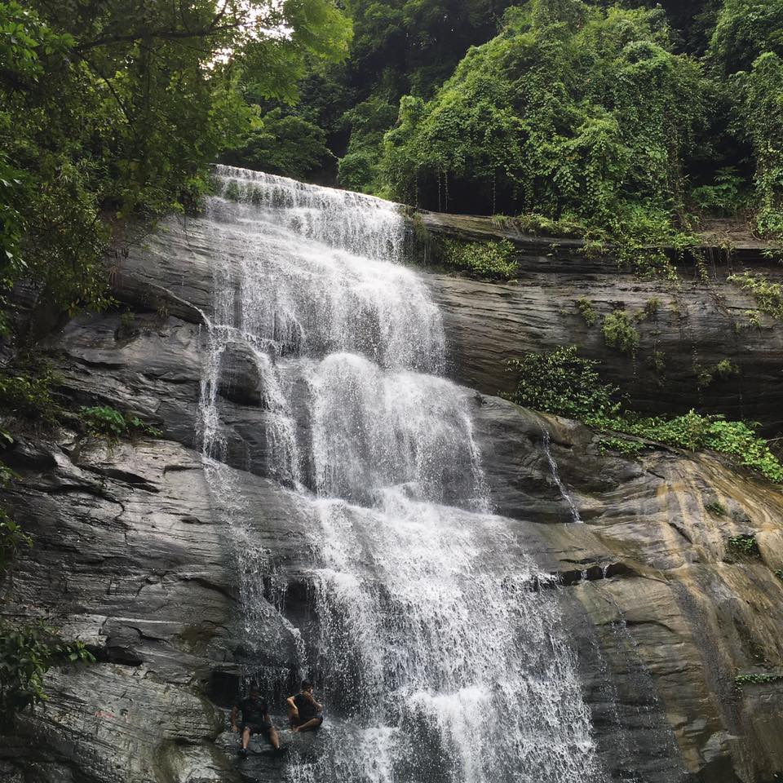

Slide 2
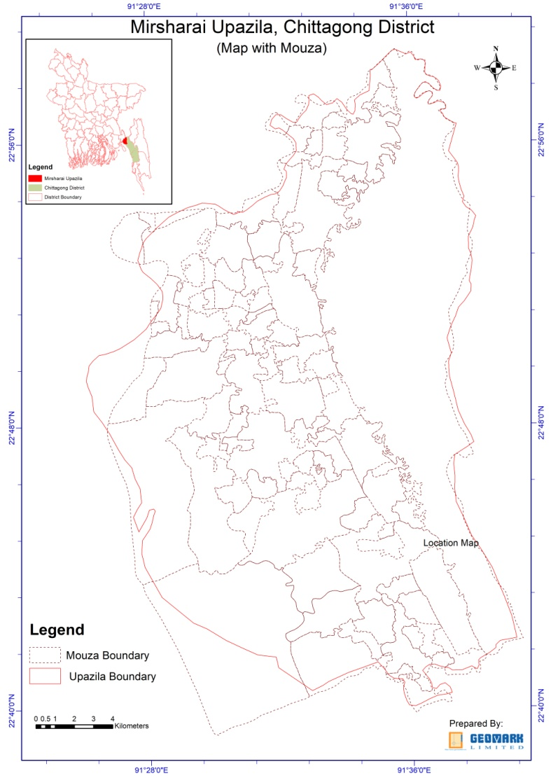
PREPARATION OF DEVELOPMENT PLAN FOR MIRSHARAI UPAZILA, CHITTAGONG DISTRICT: RISK SENSITIVE LANDUSE PLAN (MUDP).
Presentation
on
DRAFT FINAL REPORT
Package -1 Physical feature Survey
Package -3 Socio economic Survey

Slide 3
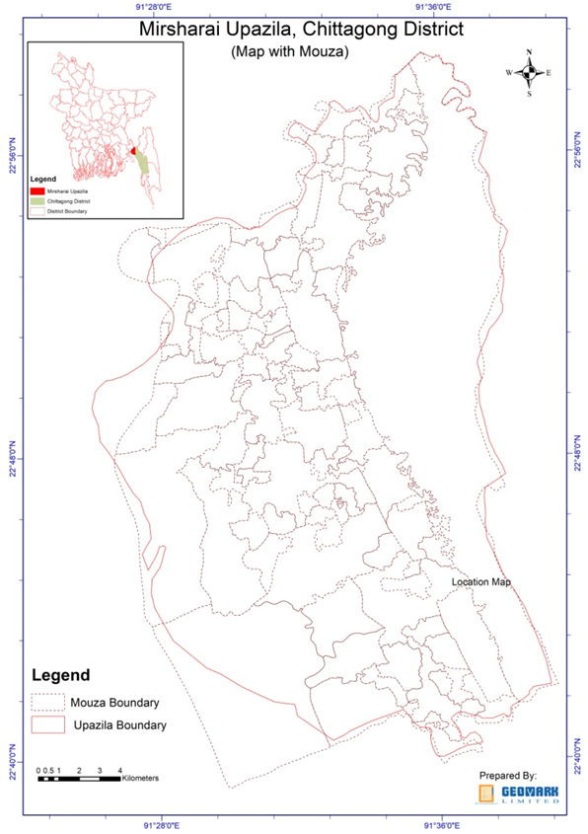
Package -01
Physical Feature
Package - 03
Socio Economic Survey

Slide 4
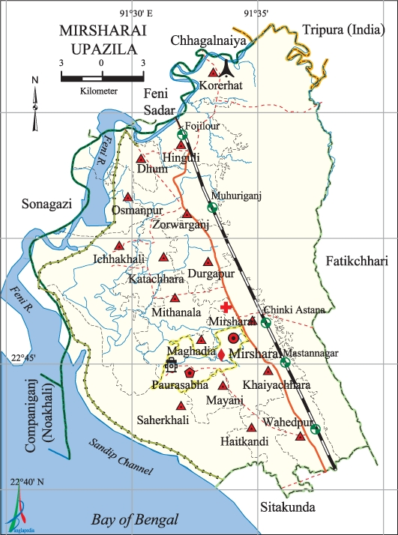
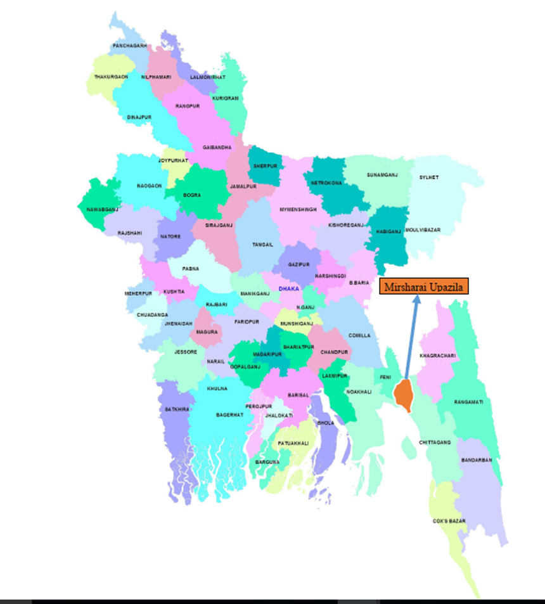
Mirsharai Upazila

Slide 5
Basic Statistics
Municipality | Union | Mouza | Village | Population |  | Density (per sq km) | Literacy Rate (%) | Area (sq km)
 |  |  |  | Urban and Other Urban | Rural
2 | 16 | 113 | 208 | 31206 | 367510 | 826 | 55.1 | 482.88

Slide 6
Basic Statistics
Number of Households of the Mirsharai Upazila
Households (HH) | 2001 | 2011
Urban | 2,236 | 5,906
Other urban | 724 | 2,428
Rural | 72,915 | 64,520
Total | 69,184 | 79,545
Source: Bangladesh Population Census 2001

Slide 7
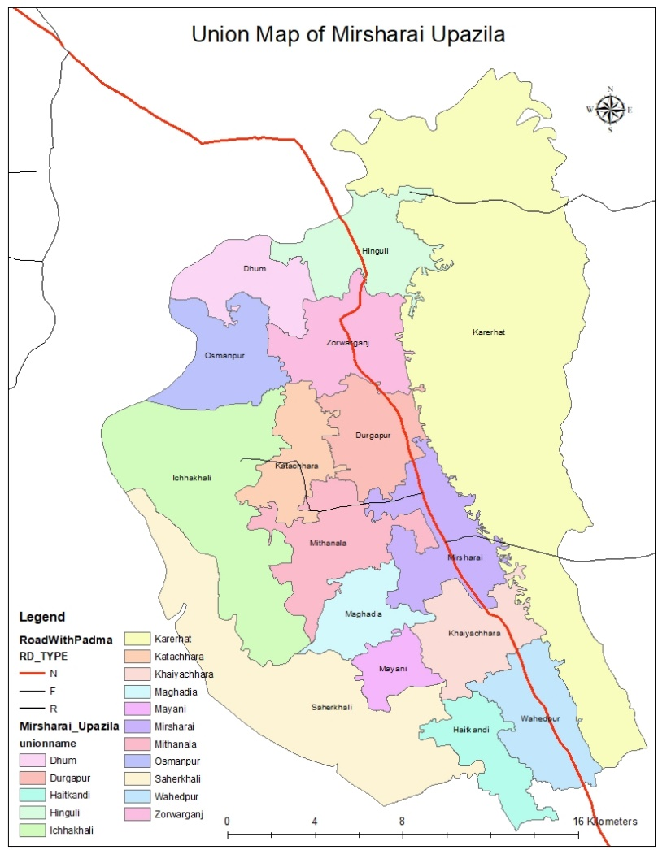
Union Map

Slide 8
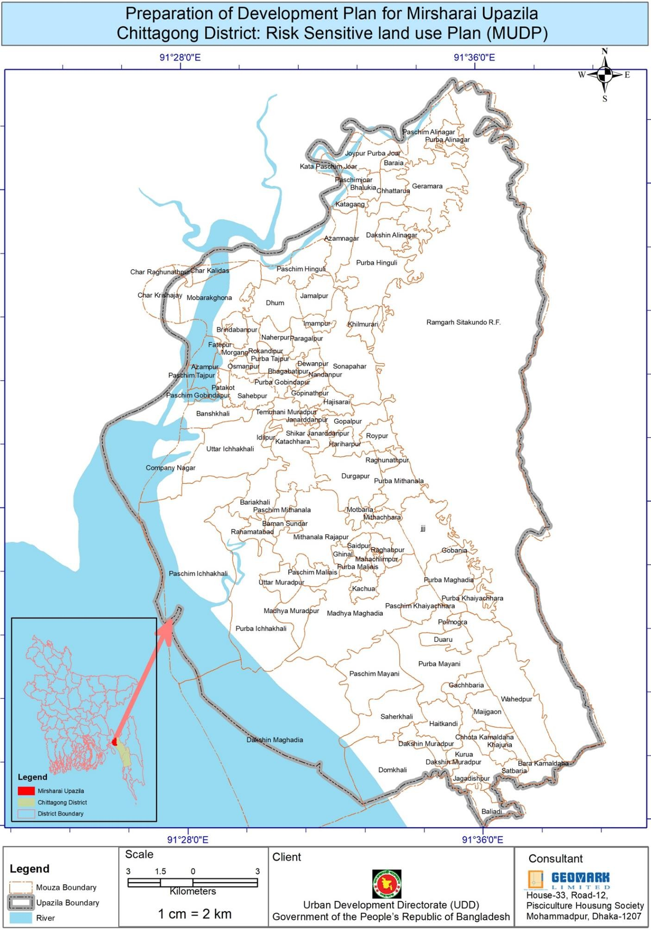
Base Map (Mouza Boundary)
Package -1
Physical Feature Survey
Findings

Slide 9
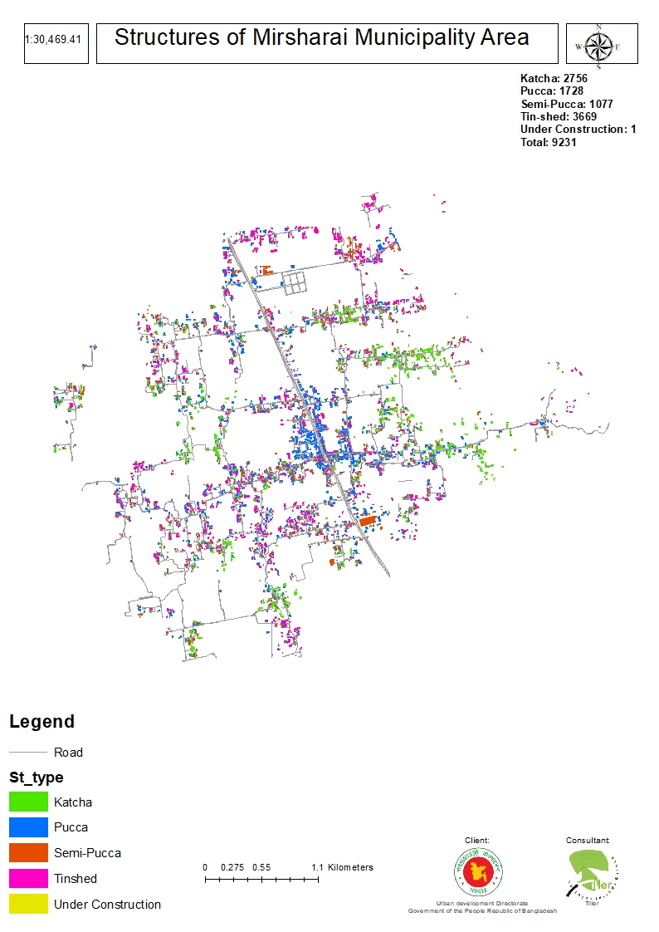
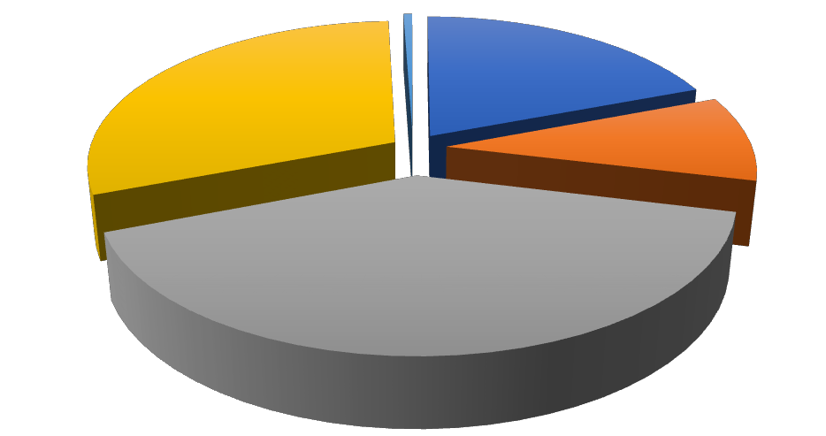
MIRSHARAI POURASHAVA FINDINGS
Building Structure Type of the Municipality Area (in %)
Wooden 1%
Under-construction 0%
Katcha 30%
Pucca 19%
Semi-pucca 9%
Tinshed 41%
Pucca Semi-pucca Tinshed Katcha Wooden Under-construction

Slide 10
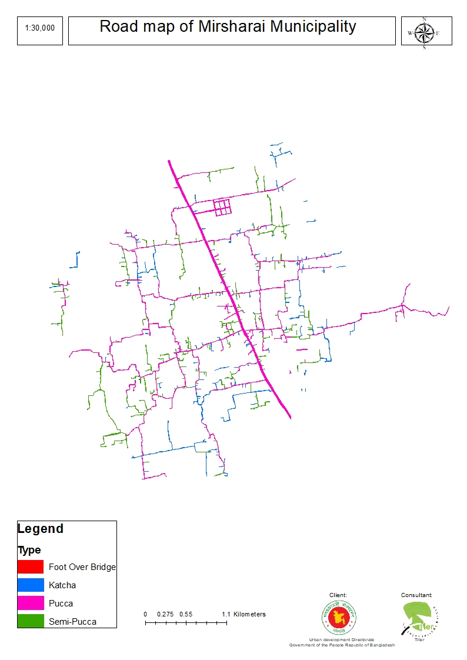
ROAD TYPE

Slide 11
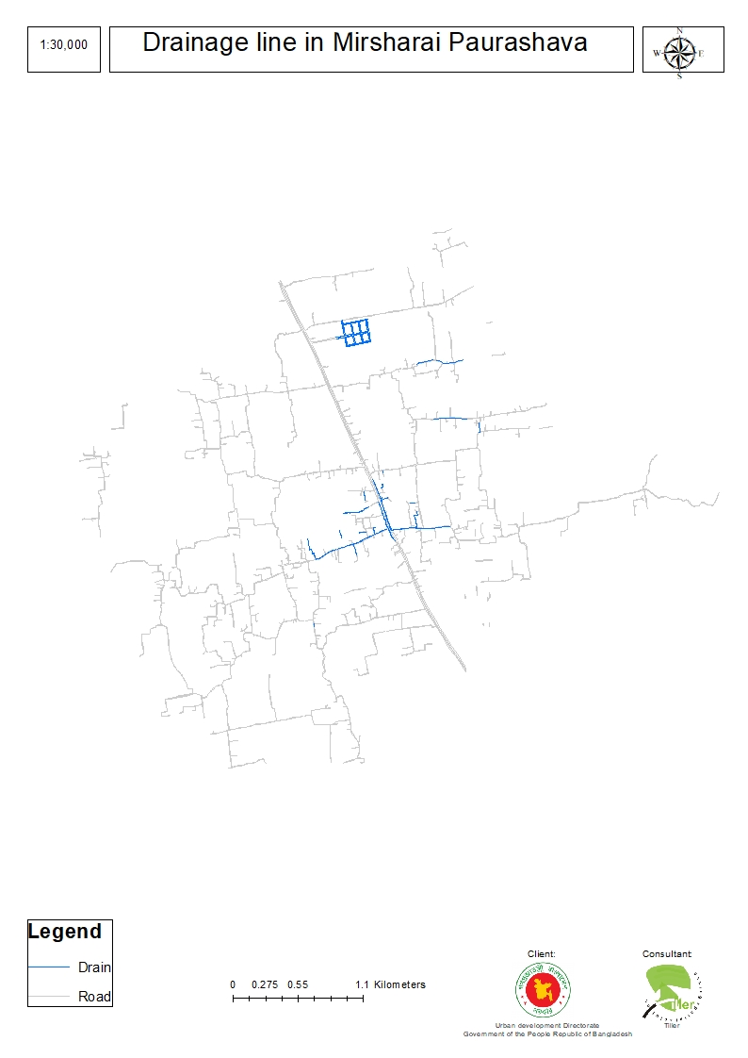
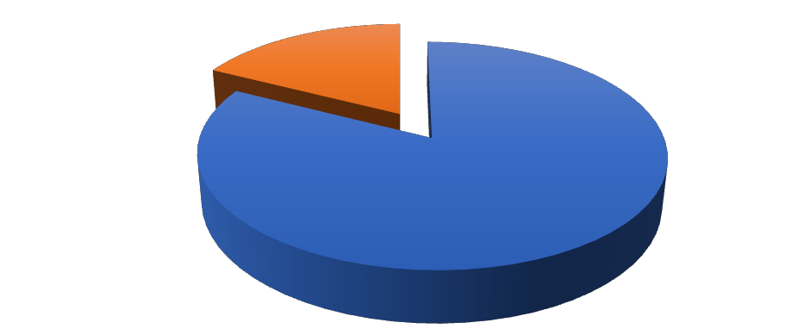
DRAINAGE SYSTEMS
Type of Drain in Mirsharai Municipality
Katcha 18%
Pucca
82%
Pucca
Katcha

Slide 12
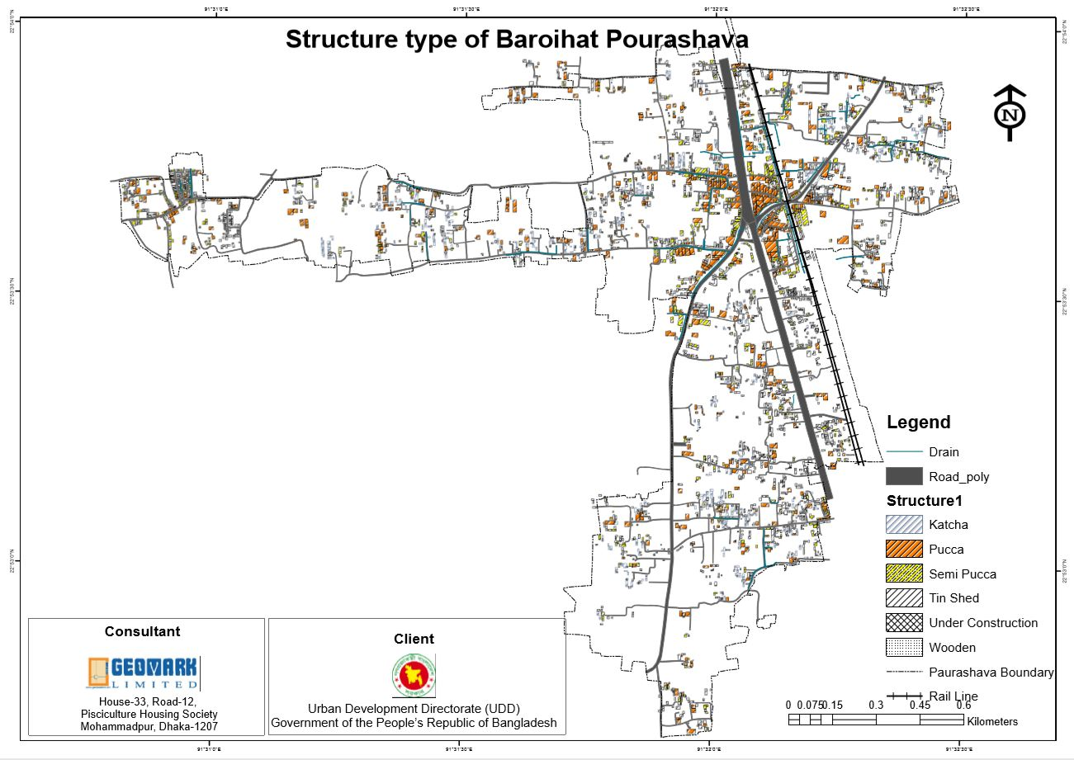
BARAIYAR HAT POURASHVA STRUCTURE TYPE
Structure Type | Number
Pucca | 681
Semi pucca | 554
Katcha | 458
Tin Shed | 1707
Under Construction | 5
Wooden | 2
Total Structure | 3407

Slide 13
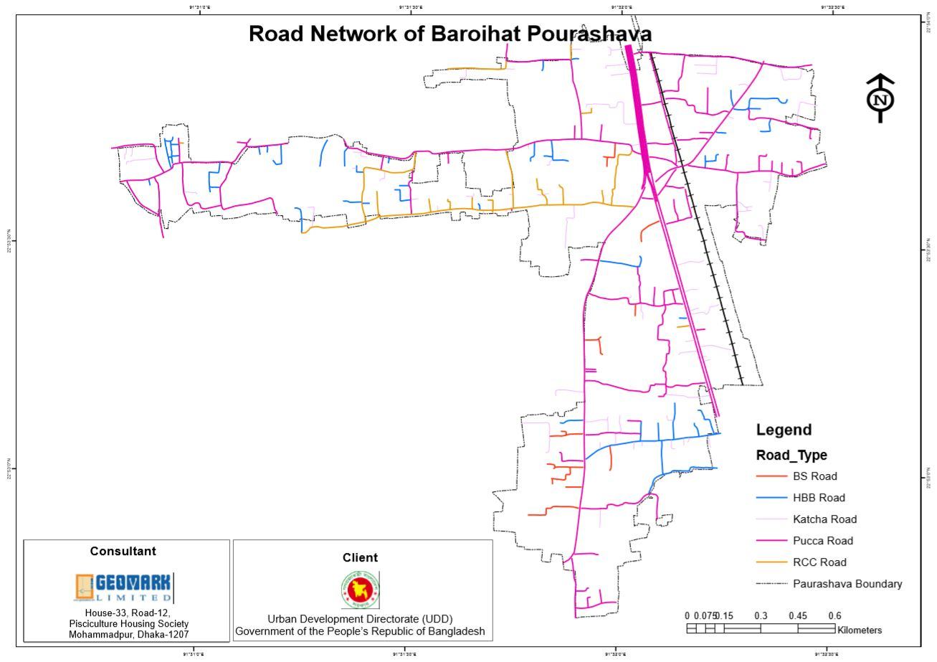
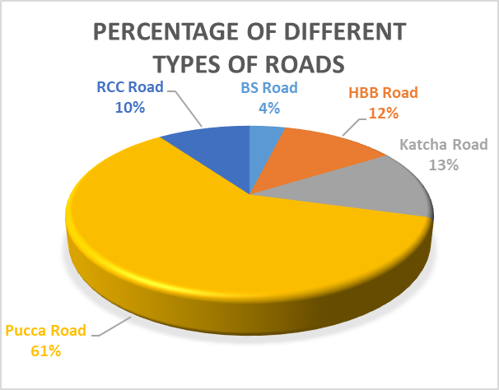
ROAD TYPE
Road Type | Length (Km)
BS Road | 1.331177
HBB Road | 4.271817
Katcha Road | 4.559328
Pucca Road | 21.114129
RCC Road | 3.432527
Total length | 34.708978

Slide 14
DRAIN TYPE
Table 17 Drainage Type
Sl No. | Type | Length (Km) | Length (m) | % | Remarks
1 | Pucca | 9.179631 | 9179.631497 | 98
2 | Katcha | 0.201198 | 201.197838 | 2

Slide 15
Sludge Management
Sl No. | Sludge Dump type | number | % | Remarks
1 | Septic Tank | 524 | 26
2 | Pit | 1109 | 54
3 | Others | 400 | 20
 |  |  | 100%

Slide 16
MIRSHARAI UPAZILA FINDINGS
SL | Structure Type | Number | % | Remarks
1 | Katcha (Fence different and roof tin and other) | 64719 | 37.574
2 | Pucca | 19710 | 11.443
3 | Semi Pucca | 18319 | 10.635
4 | Tin Shed (fence and roof) | 69351 | 40.263 | Predominant Structure
5 | Under Construction | 144 | 0.084
6 | Wooden | 2 | .0001
 | Total Structure | 172245 | 100

Slide 17
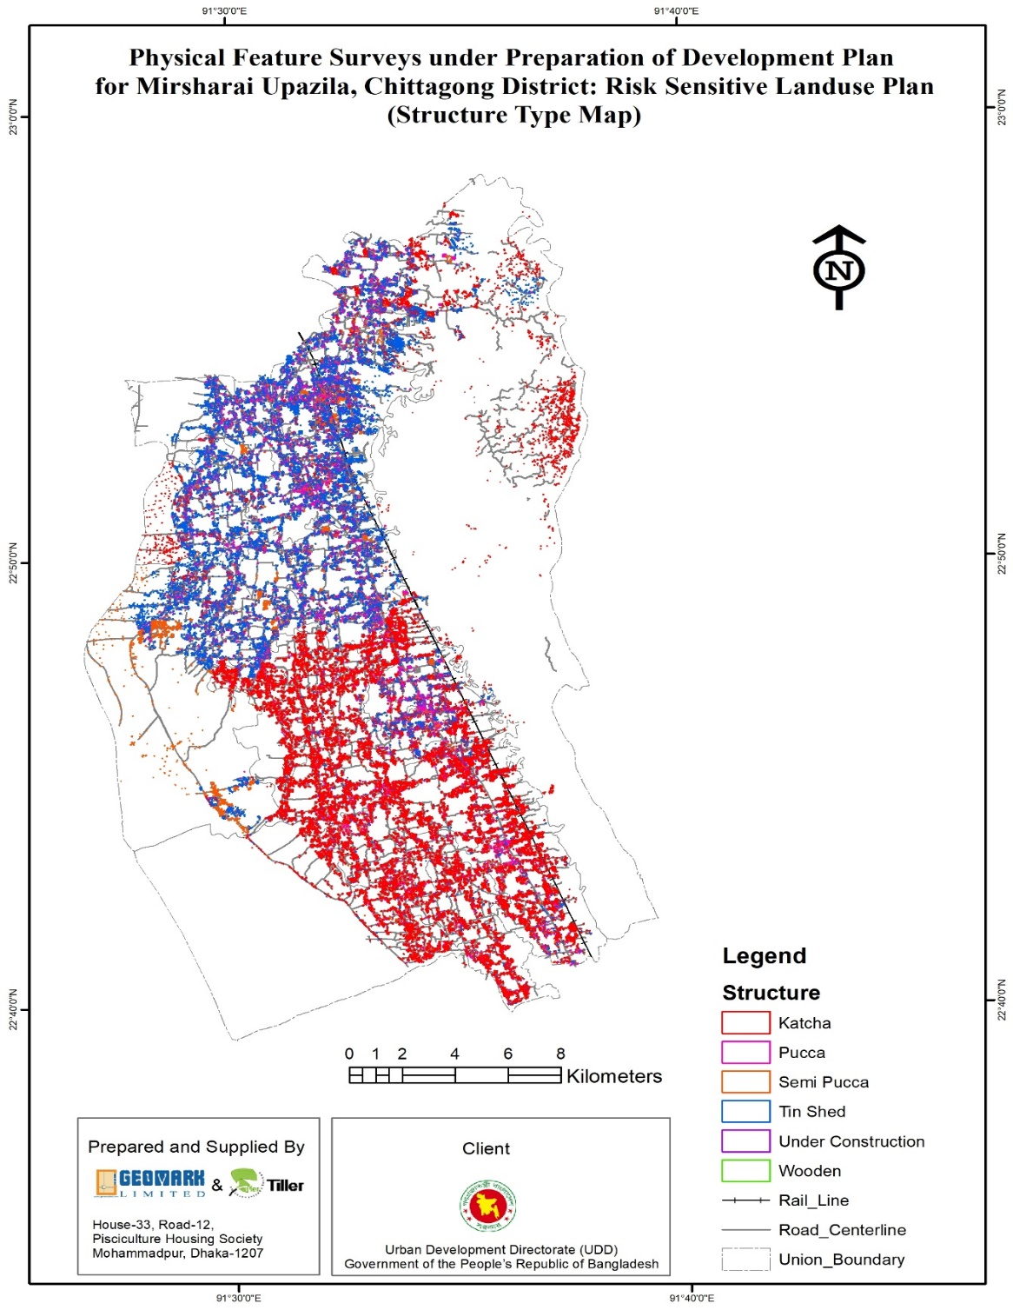
STRUCTURE MAP

Slide 18
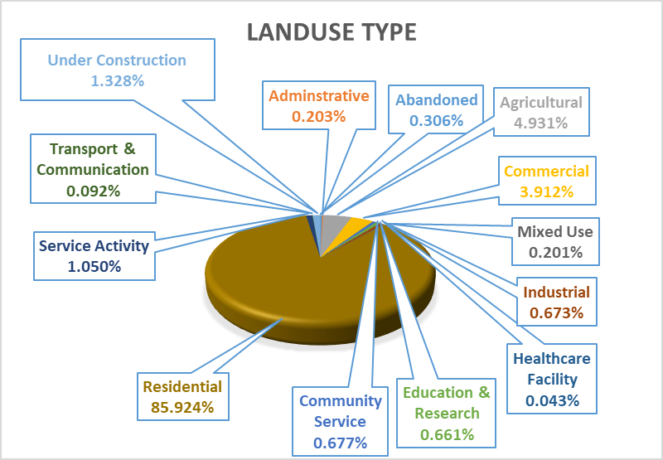
Building Structure Use
SL | Structure Type | Number | % | Remarks
1 | Administrative | 349 | .203
2 | Agricultural | 8495 | 4.931
3 | Commercial | 6740 | 3.912
4 | Community Service | 1166 | .677
5 | Education & Research | 1139 | .661
6 | Healthcare Facility | 74 | .043
7 | Industrial | 1159 | .673
8 | Mixed Use | 346 | .201
9 | Residential | 148020 | 85.924 | Predominant use
10 | Service Activity | 1808 | 1.050
11 | Transport & Communication | 158 | .092
12 | Under Construction | 2287 | 1.328
13 | Abandoned | 528 | .306
 | Amount | 172245 | 100%

Slide 19
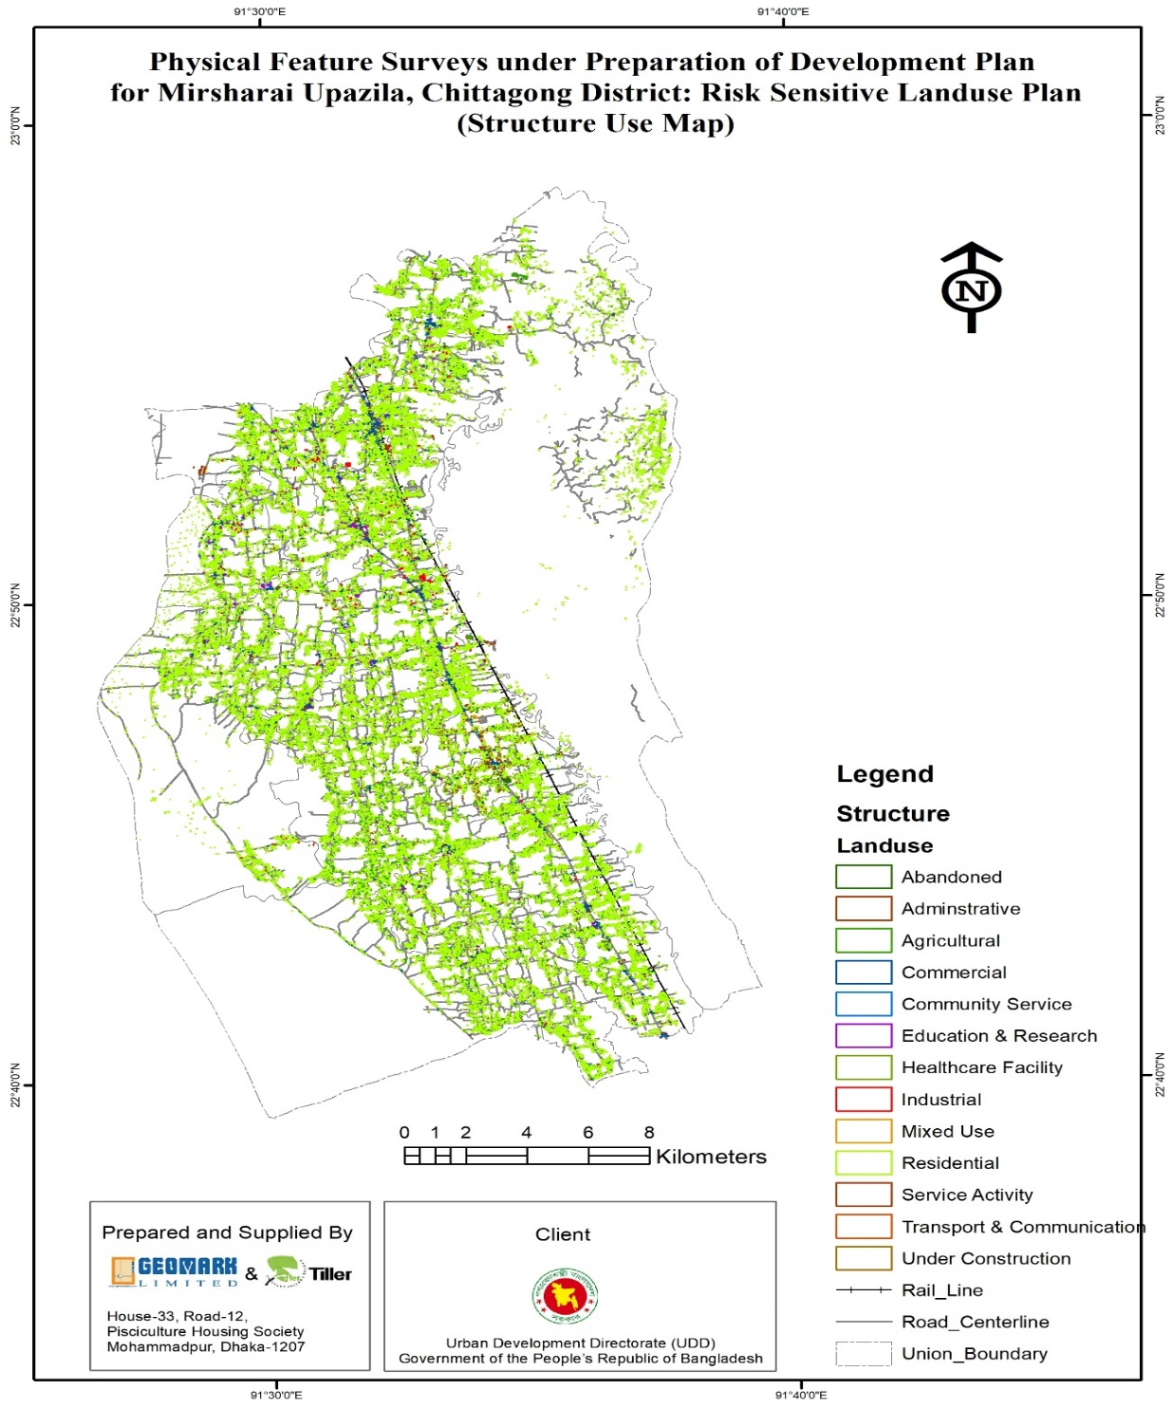
Structure Use
Map

Slide 20
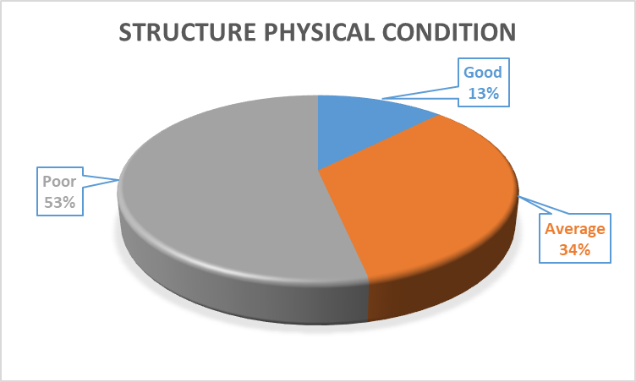
Structure Condition
Sl No. | Structure Condition | Structure Number | % | Remarks
1 | Good | 21399 | 13
2 | Average | 58875 | 53
3 | Poor | 91971 | 53 | Predominant poor
Total |  |  | 100%

Slide 21
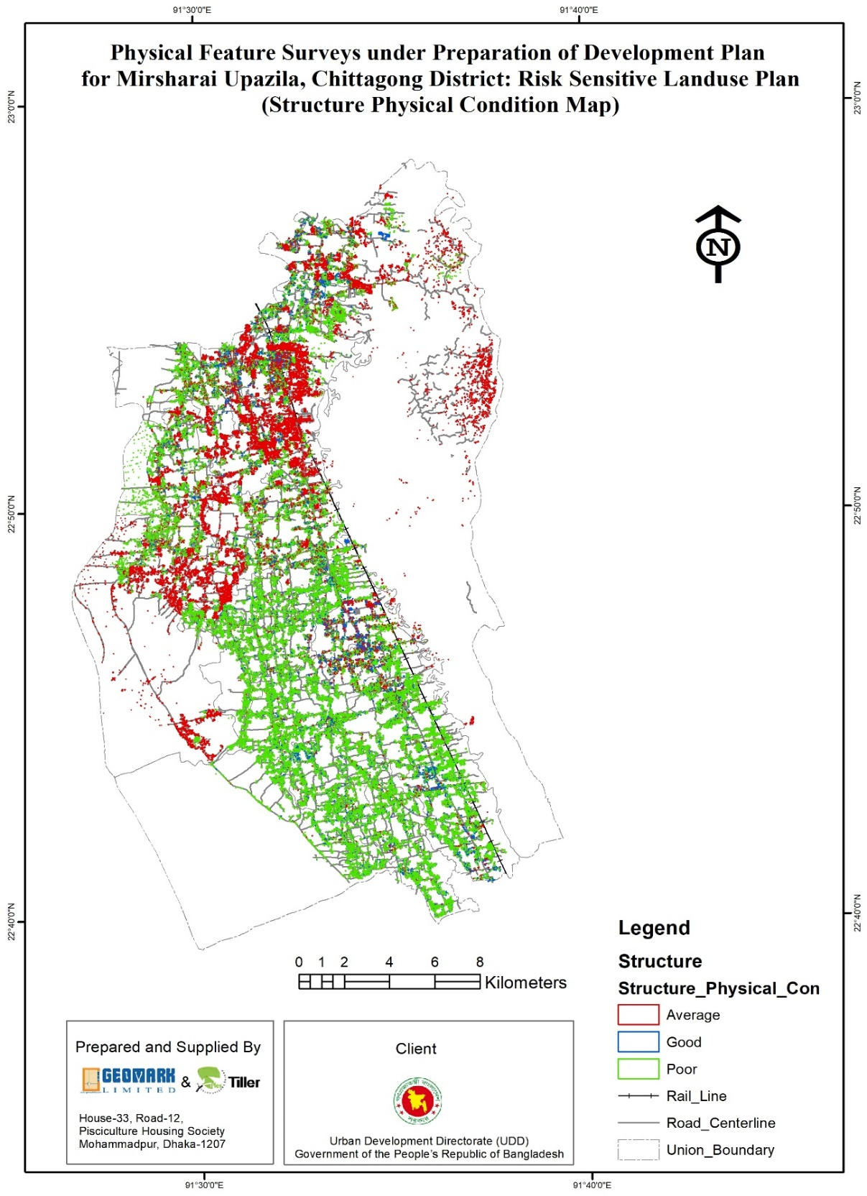


Slide 22
Water Bodies
Sl No. | Water body Type | Number | Remarks
1 | Canal | 58
2 | Ditch | 3392
3 | Lake | 1
4 | Pond | 18868
5 | River | 2

Slide 23
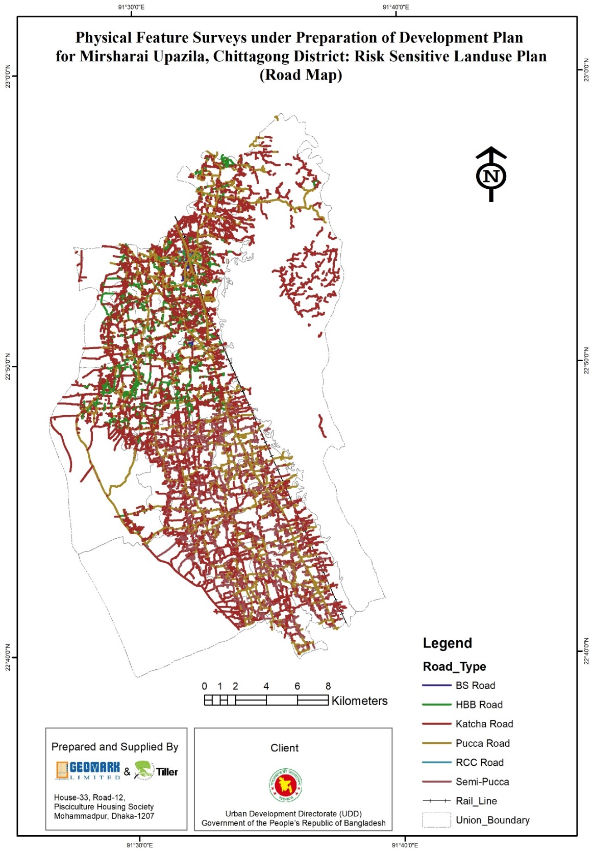
ROAD NETWORK

Slide 24
Water Bodies
Sl No. | Water body Type | Number | Remarks
1 | Canal | 58
2 | Ditch | 3392
3 | Lake | 1
4 | Pond | 18868
5 | River | 2

Slide 25
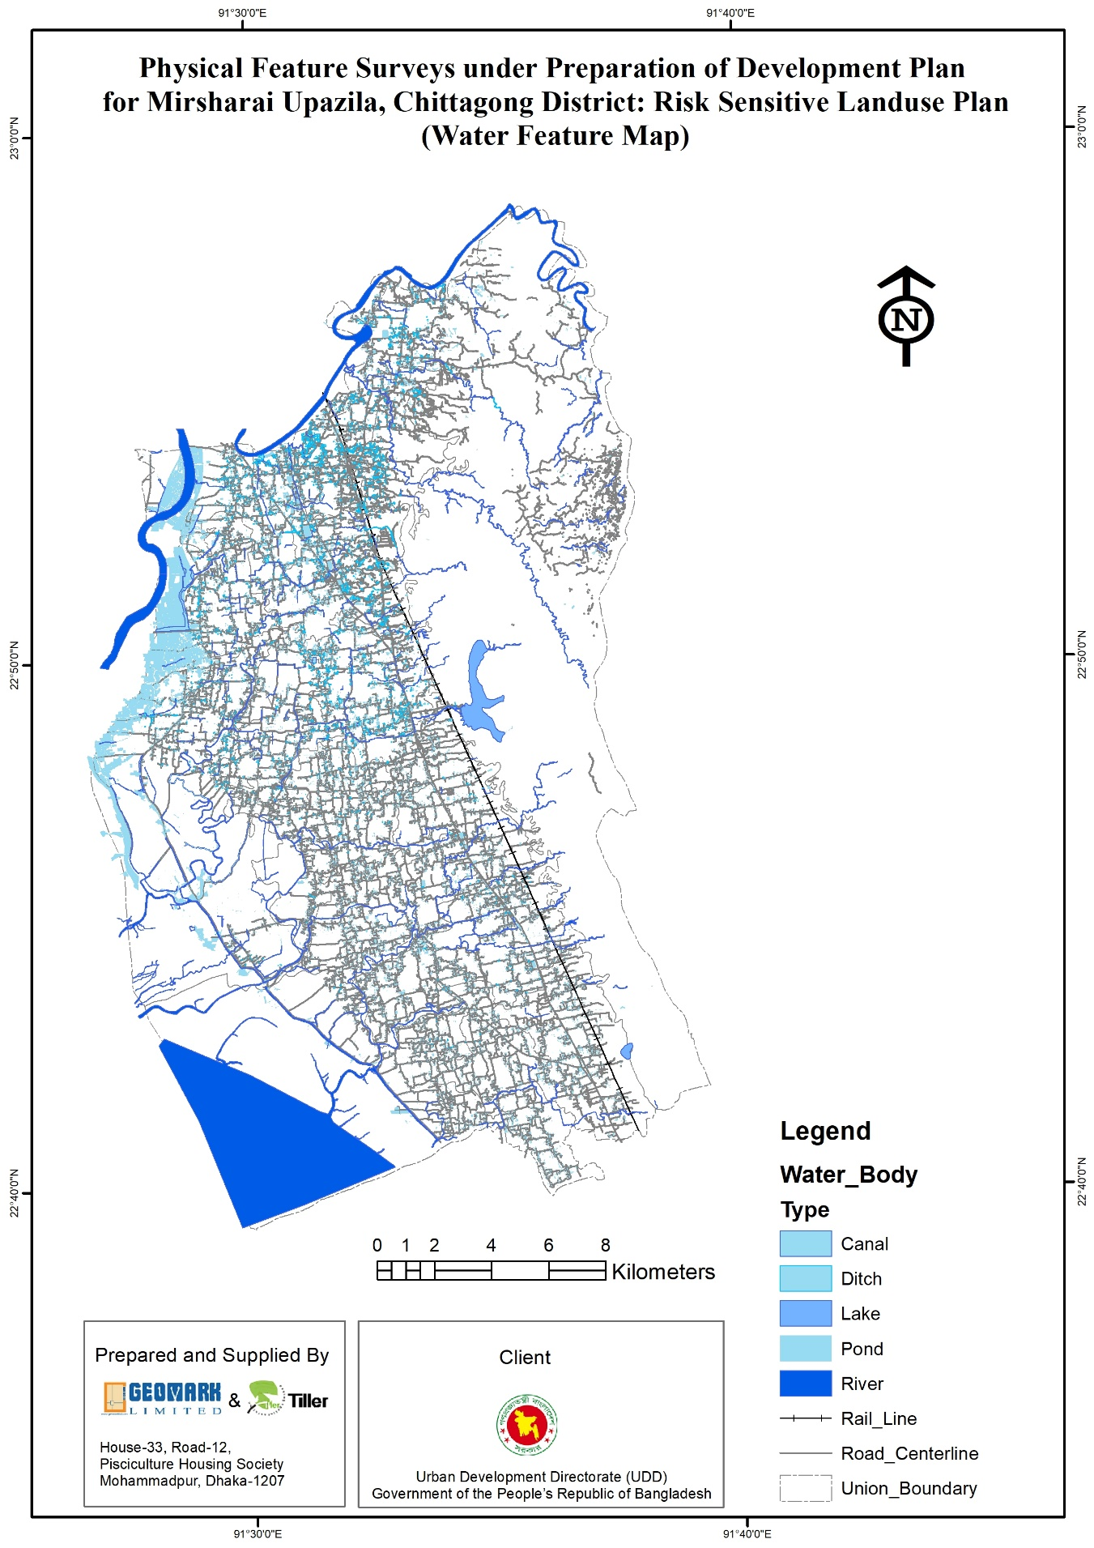


Slide 26
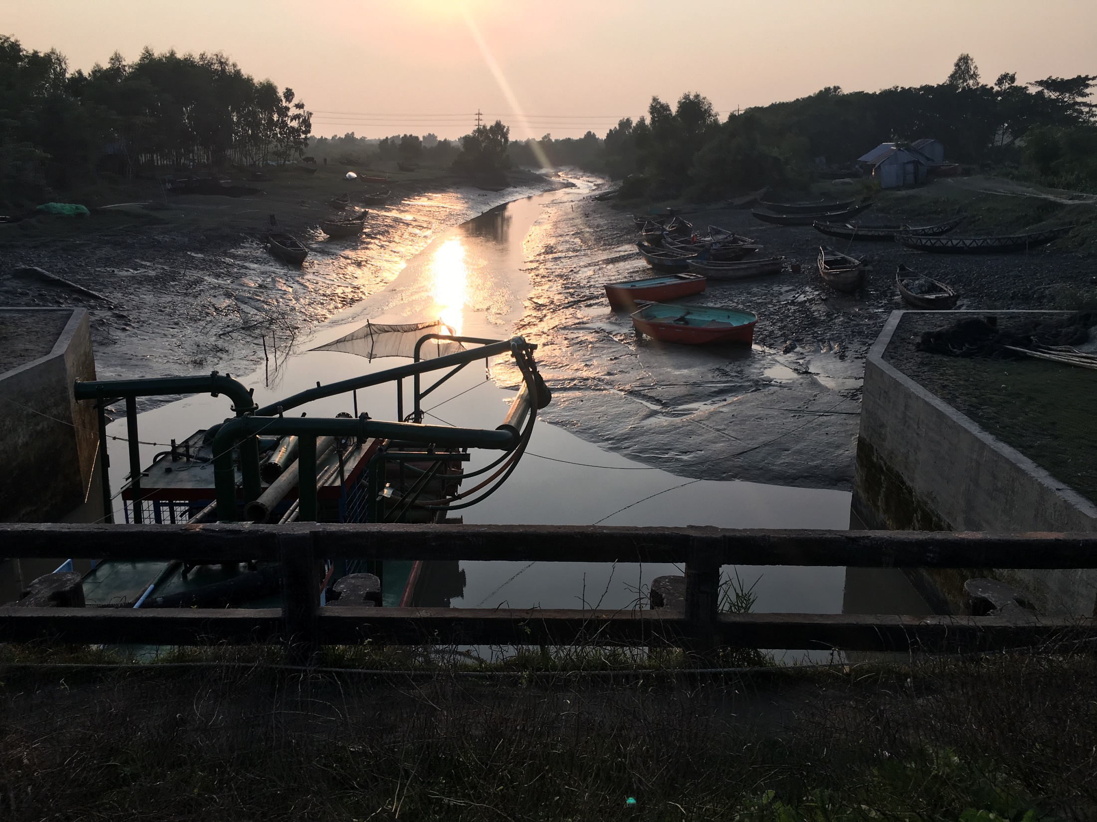
THANK YOU
END PACKAGE -1

Slide 27
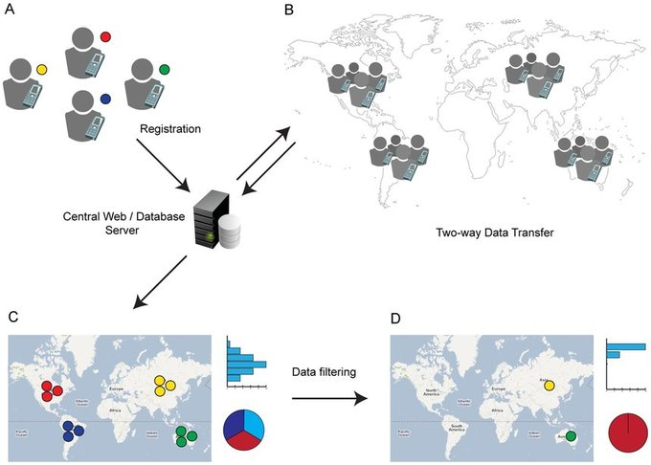
Package -3
Socio Economic & Other Survey
Findings

Slide 28
House Hold Survey
Age of the Respondents
Categories | Frequency | Percent | Valid Percent | Cumulative Percent
10-19 | 39 | 3.0 | 3.0 | 3.0
20-29 | 134 | 10.3 | 10.3 | 13.3
30-39 | 203 | 15.6 | 15.6 | 28.9
40-49 | 289 | 22.2 | 22.2 | 51.2
50-59 | 303 | 23.3 | 23.3 | 74.5
60-69 | 227 | 17.5 | 17.5 | 91.9
70-79 | 80 | 6.2 | 6.2 | 98.1
80+ | 25 | 1.9 | 1.9 | 100.0
Total HH | 1300 | 100.0 | 100.0

Slide 29
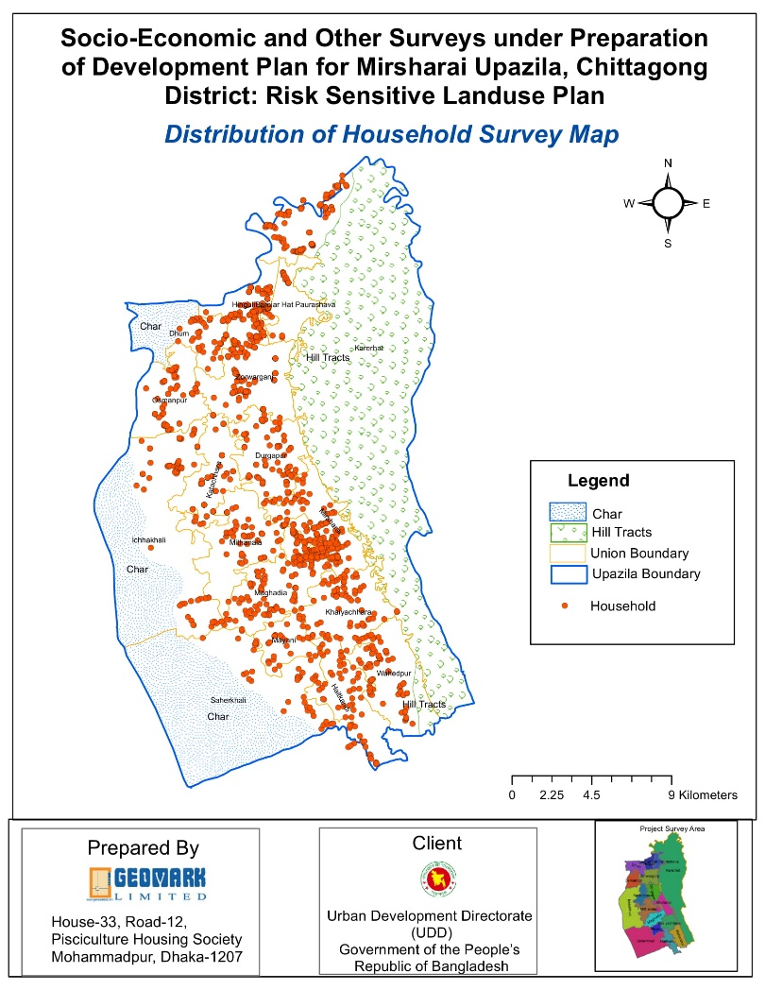
Distribution of Respondents
Tale 4.1.2: Distribution of Respondents
Categories | Frequency | Percent | Valid Percent | Cumulative Percent
Male | 719 | 55.3 | 55.3 | 55.3
Female | 581 | 44.7 | 44.7 | 100.0
Total | 1300 | 100.0 | 100.0
Source: Field Survey 2018

Slide 30
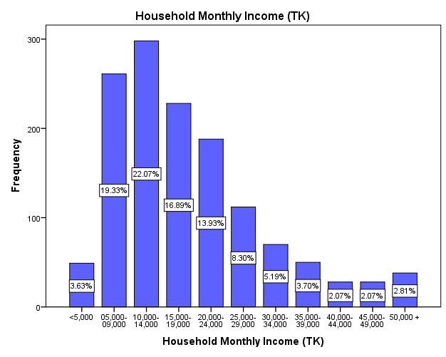
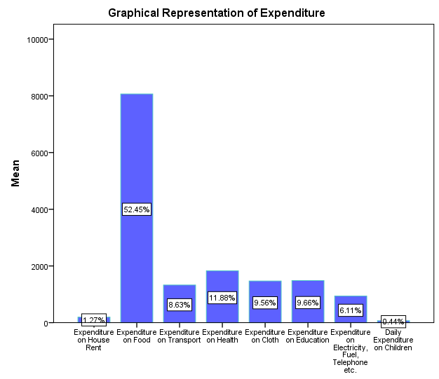
HOUSE HOLD
INCOME &EXPENDITURE

Slide 31
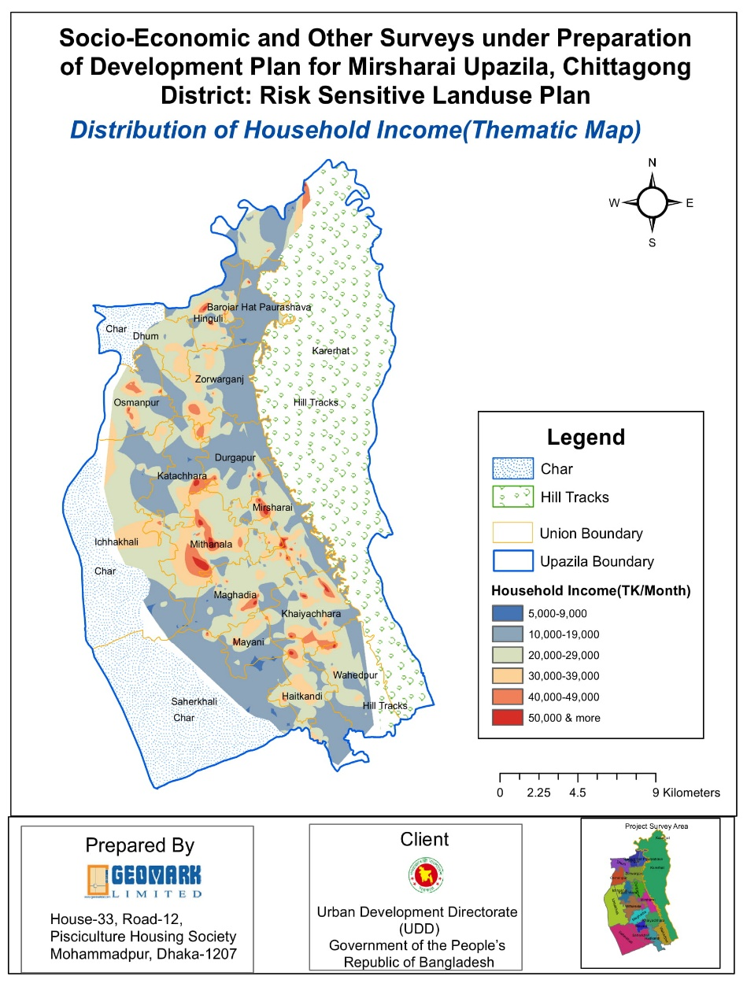
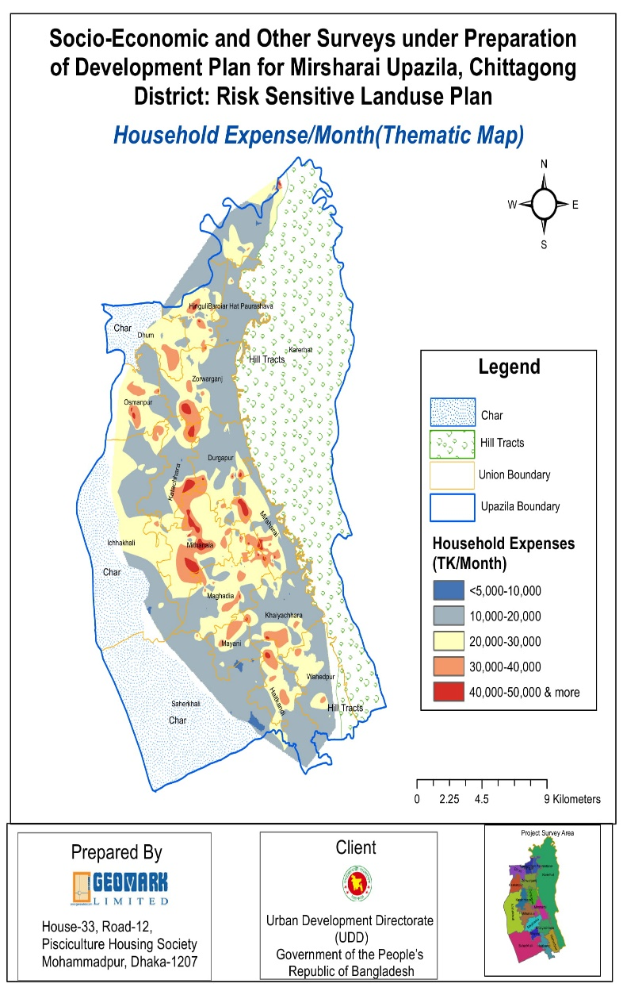
HOUSE HOLD
INCOME ,EXPENDITURE MAP

Slide 32
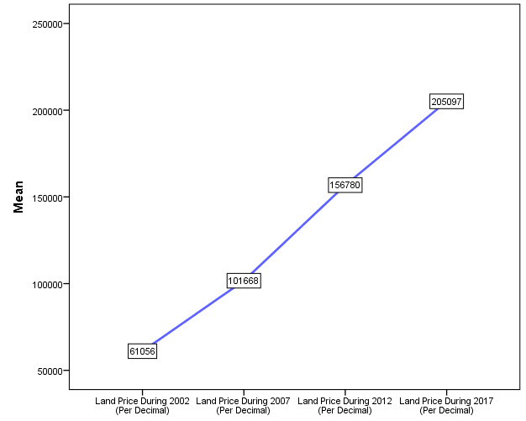
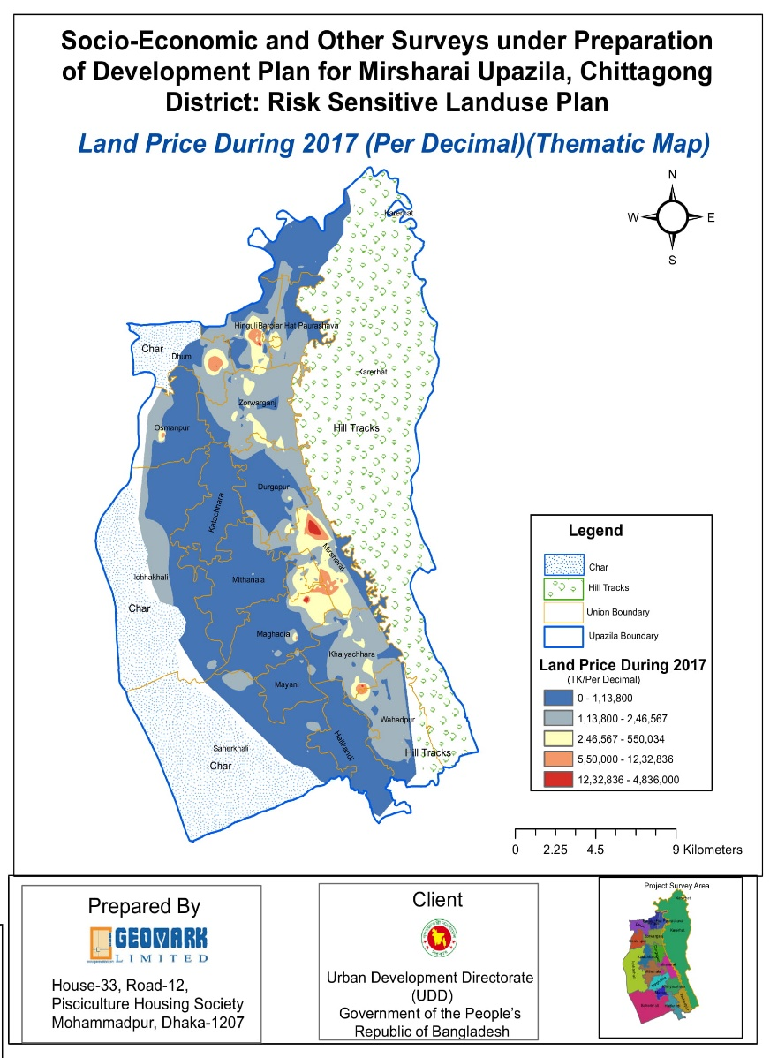
TREND OF LAND PRICE

Slide 33
WATER SOURCE & QUALITY
Source of Water
Categories | Frequency | Percent | Valid Percent | Cumulative Percent
Comon Tube well | 70 | 5.2 | 5.2 | 5.2
Pipeline | 38 | 2.8 | 2.8 | 8.0
Tubewell | 1160 | 85.9 | 85.9 | 93.9
Pond | 43 | 3.2 | 3.2 | 97.1
River/Canal | 39 | 2.9 | 2.9 | 100.0
Total | 1350 | 100.0 | 100.0
Quality of Water
Categories | Frequency | Percent |  | Valid Percent | Cumulative Percent
Arsenic Contaminated | 122 | 9.0 |  | 9.0 | 9.0
Drinkable | 1199 | 88.8 |  | 88.8 | 97.9
Not Drinkable | 29 | 2.1 | 2.1 |  | 100.0
Total | 1350 | 100.0 |  | 100.0

Slide 34
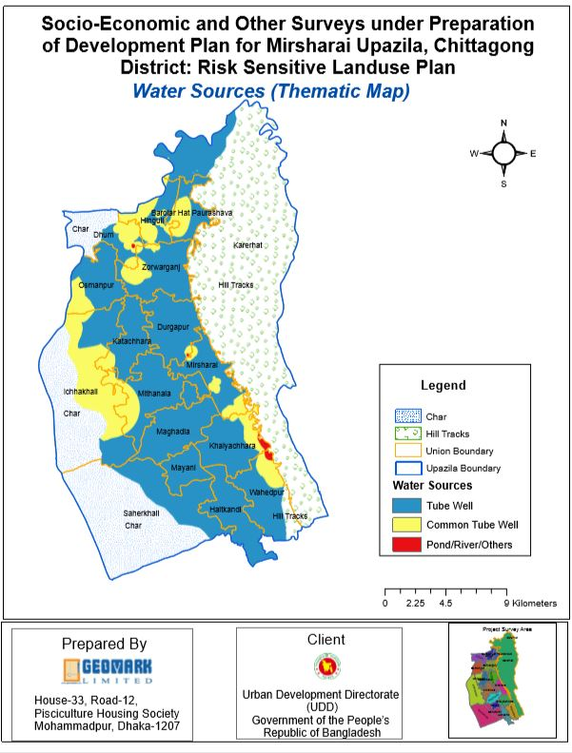
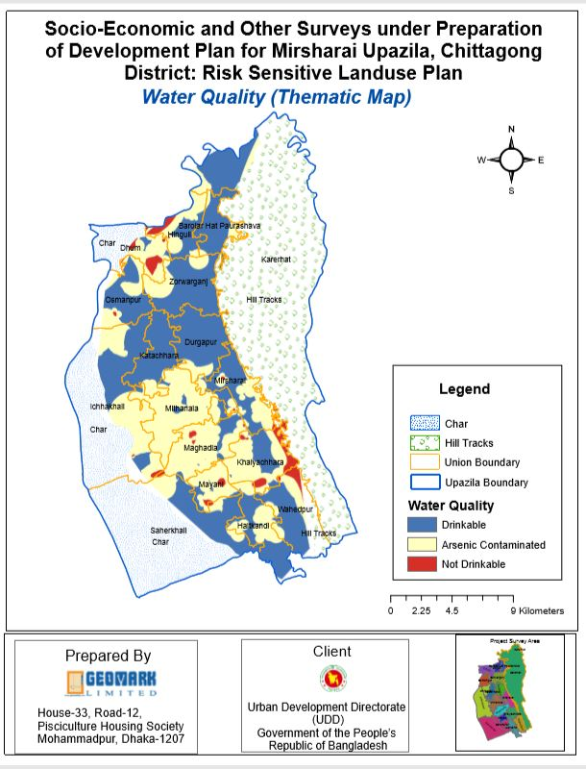
WATER SOURCE & QUALITY MAP

Slide 35
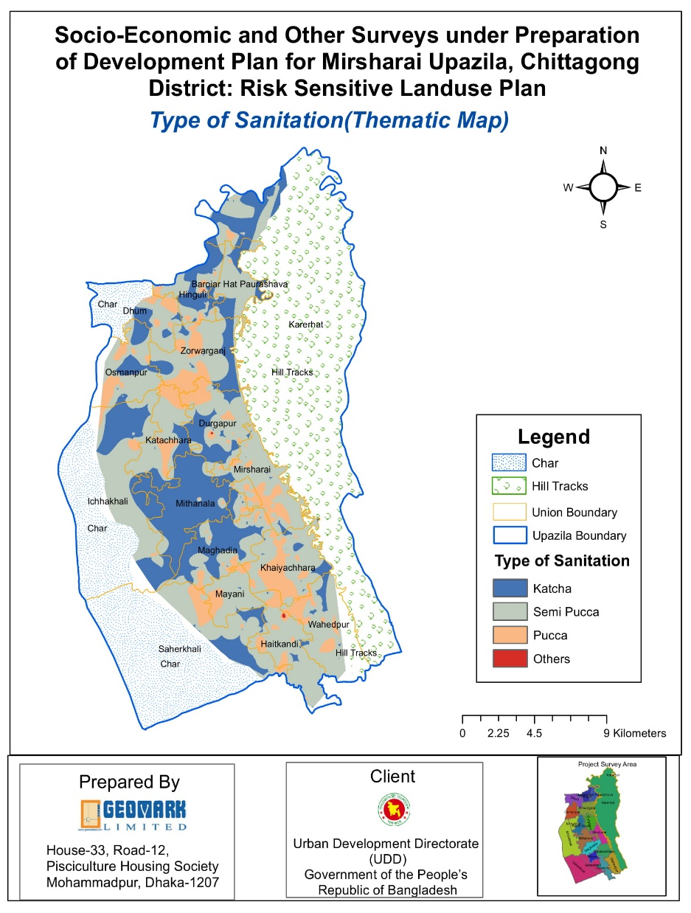
Sanitation
Type of Sanitation
Categories | Frequency | Percent | Valid Percent | Cumulative Percent
Katcha | 783 | 58.0 | 58.0 | 58.0
Pucca | 334 | 24.7 | 24.7 | 82.7
Semi Pucca | 233 | 17.3 | 17.3 | 100.0
Total | 1350 | 100.0 | 100.0

Slide 36
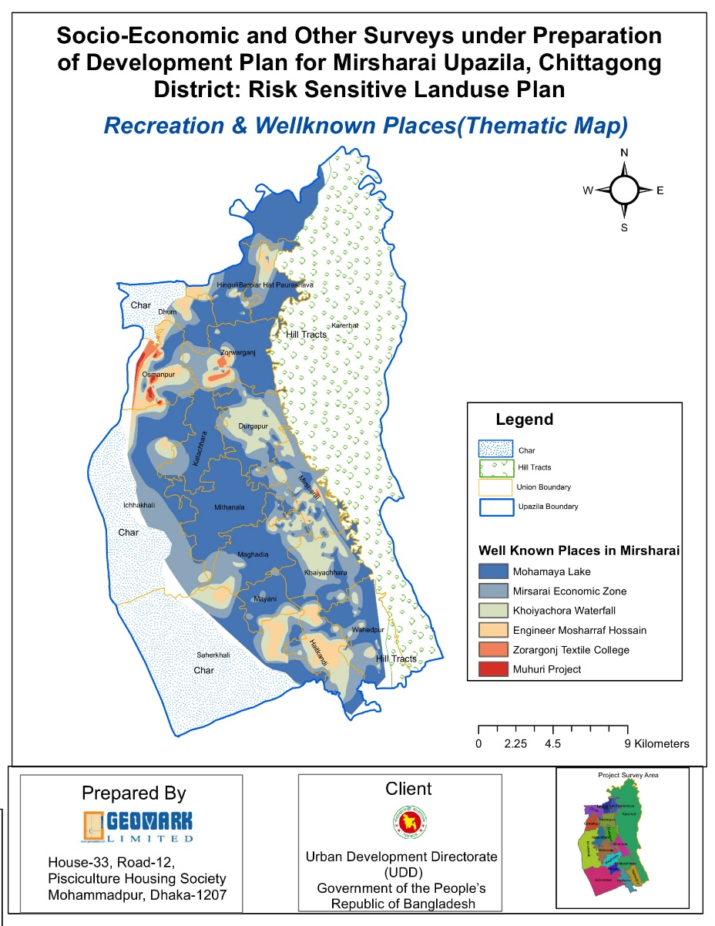
Location for Recreation Centre
Location for Recreation
Categories | Frequency | Percent | Valid Percent | Cumulative Percent
Chittagong City/Cox's Bazar/Feni/Others | 7 | 2.0 | 2.0 | 2.0
Khaiyachara/Napittachara Waterfall | 31 | 8.8 | 8.8 | 10.7
Local Town/Playing Field/Backyard | 200 | 56.5 | 56.5 | 67.2
Mohamaya Lake | 64 | 18.1 | 18.1 | 85.3
Shoping Mall | 43 | 12.1 | 12.1 | 97.5
Sitakundo Hill Area | 9 | 2.5 | 2.5 | 100.0
Total | 354 | 100.0 | 100.0

Slide 37
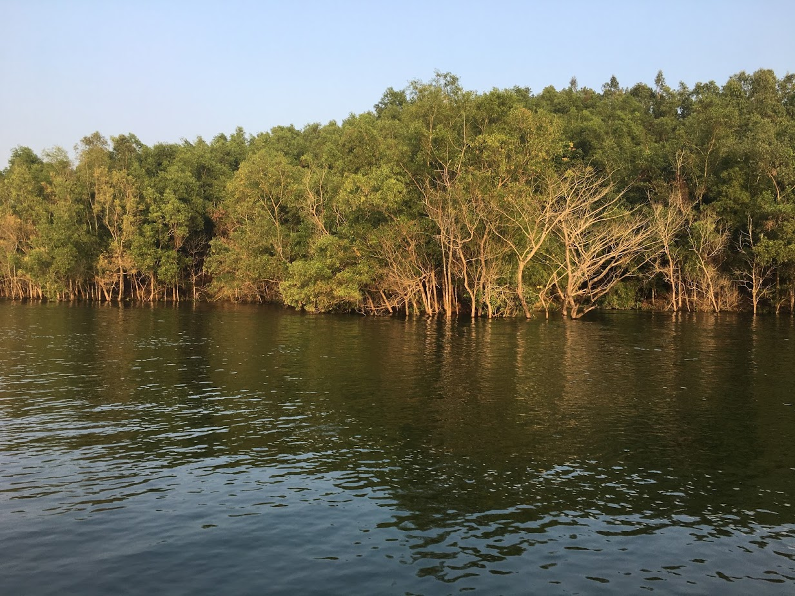

Slide 38
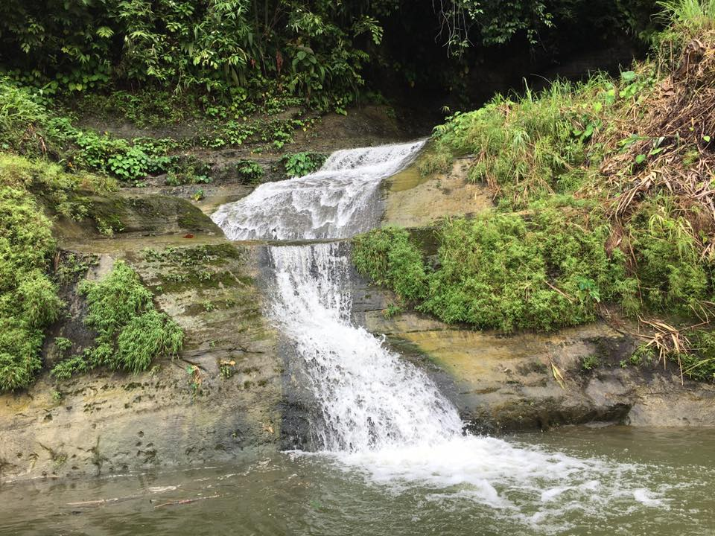

Slide 39
